Slide 1

Presents

Slide 2

Clean Energy Today
for a Better Tomorrow

Slide 3
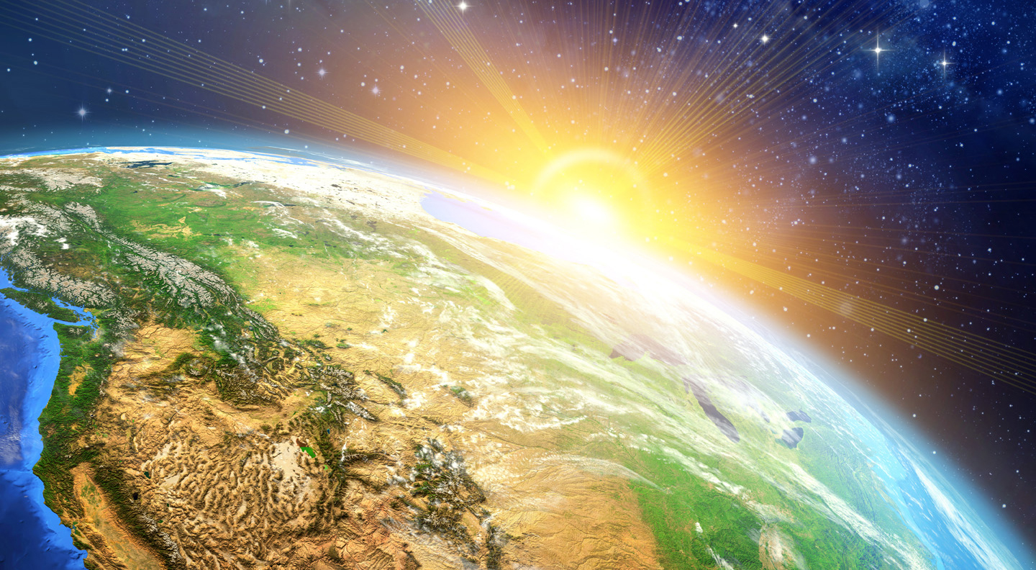
An Innovative Solution
to Our Energy Needs

Slide 4

Earth: Our Common Home
Planet of extraordinary beauty
Amazing natural resources
Huge potential of solar, tidal, wind
and geothermal energy

Slide 5
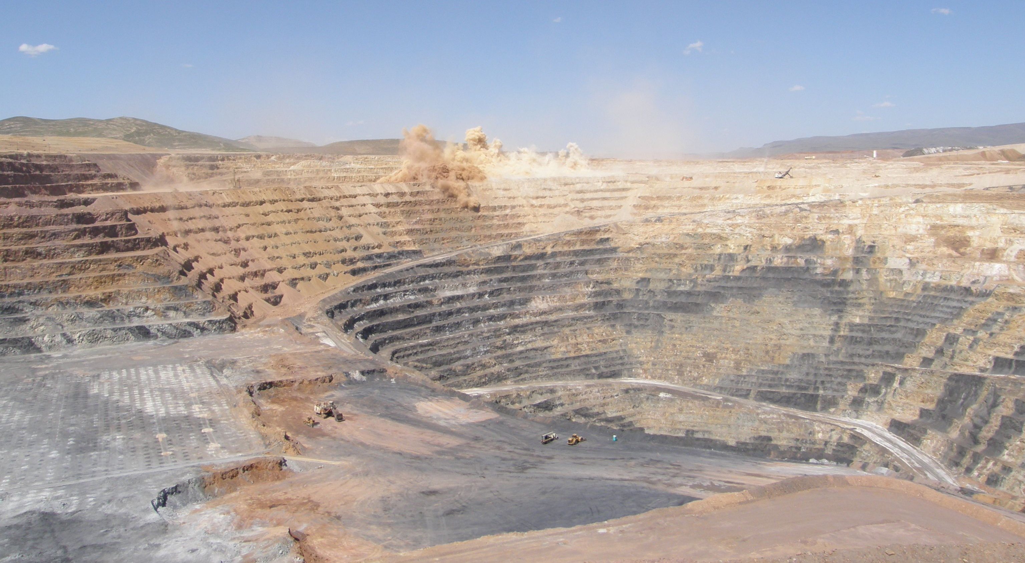
The Down Side
Unsustainable dependence on
fossil fuels
Depletion of resources

Slide 6
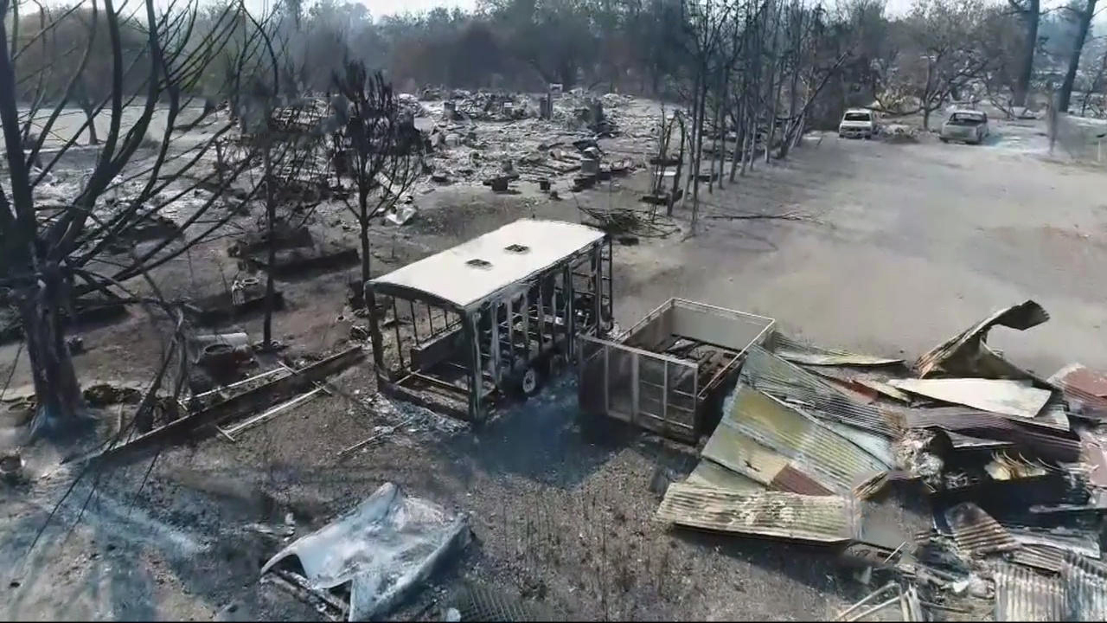
Degradation by toxic waste causing
pollution & disease
Increase in climate emergencies

Slide 7

The Result
Anxiety for the future
Feeling of powerlessness

Slide 8
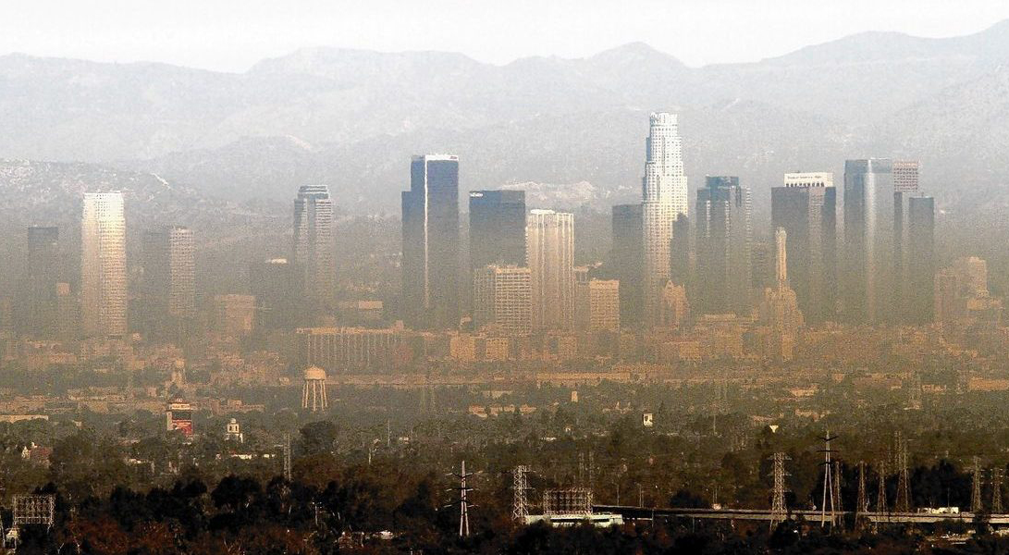
Burning fossil fuels has become
unacceptable
More and more demand for clean,
efficient, sustainable energy

Slide 9


We all want to make a difference.
We just don’t know how.

Slide 10
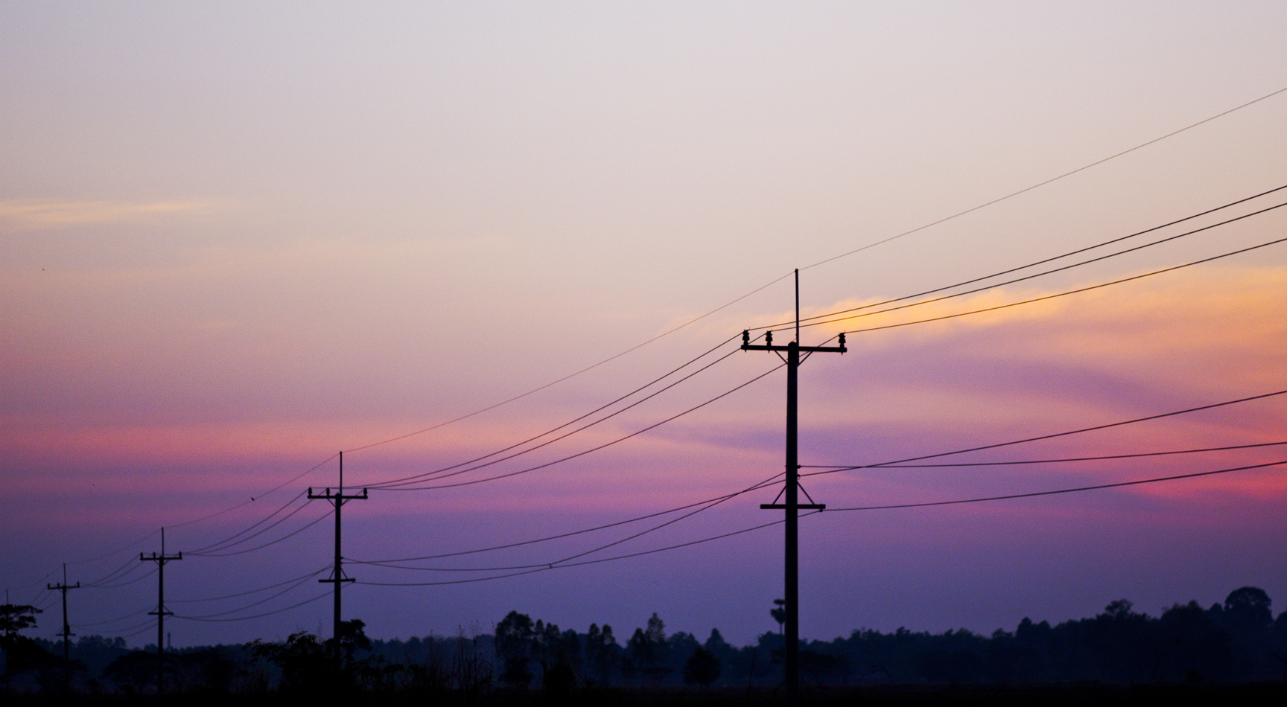
Fossil Fuels …
Constant and dependable electricity
Efficient and economical

Slide 11
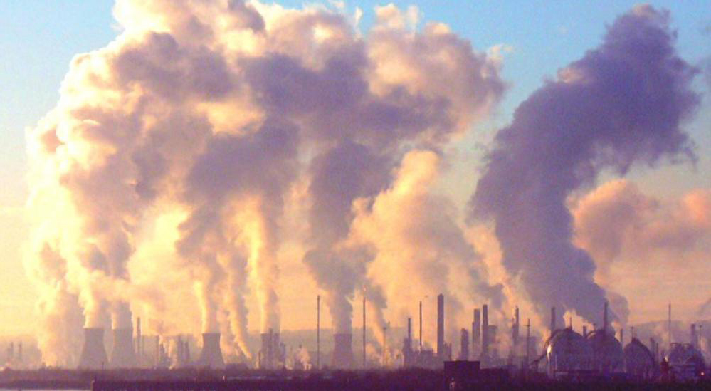
Fossil Fuels …
But…
Source of enormous pollution
Millions of years to develop

Slide 12
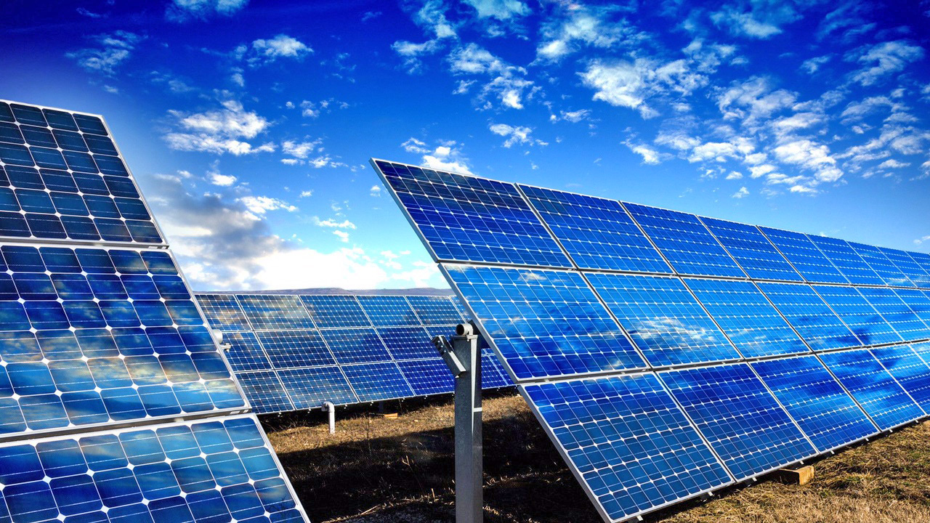
The Perfect Solution?
Use nature’s own non-polluting power
to generate electricity
Convert every watt into a storable form
for dependability

Slide 13
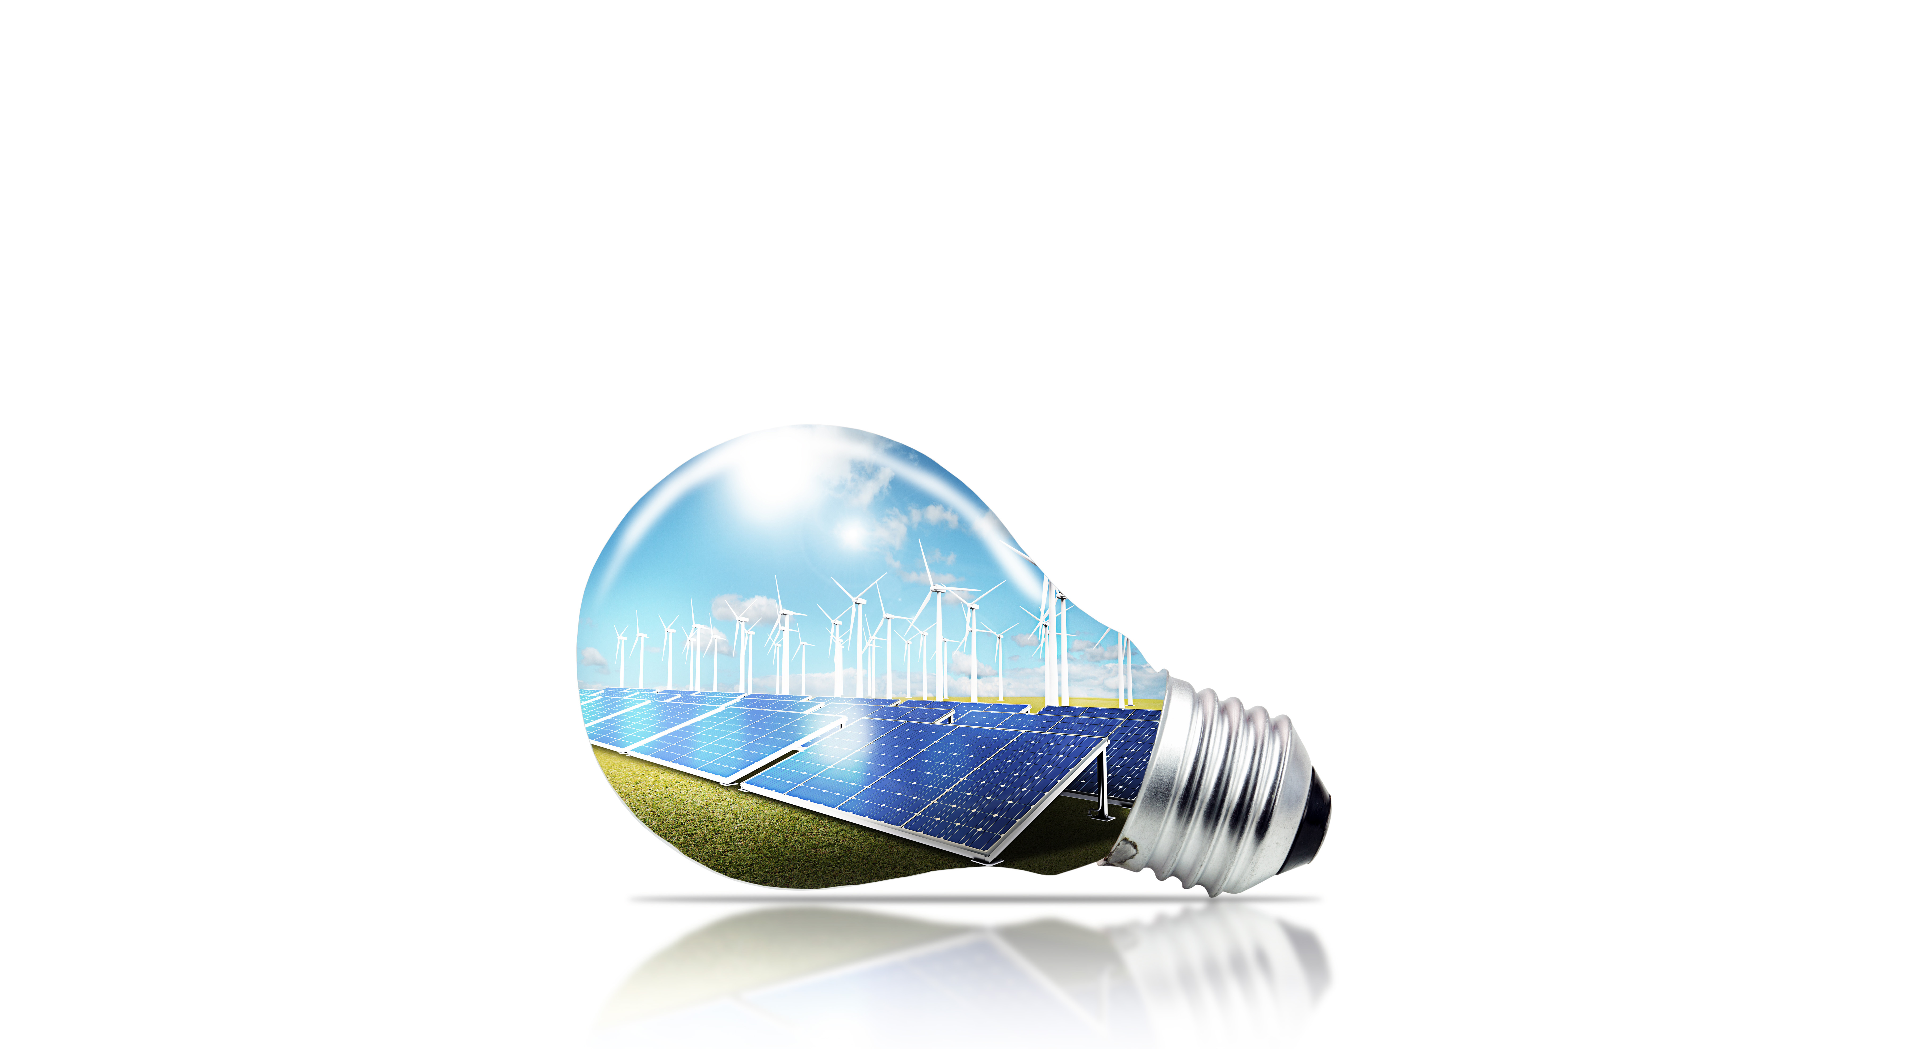
Our Concept:
Innovation vs Invention

Slide 14

Two decades of vision, research, refinement
Straightforward and logical
Adaptable to any location

Slide 15
Unique fusion of existing technologies
More valuable than the sum of its parts

Slide 16
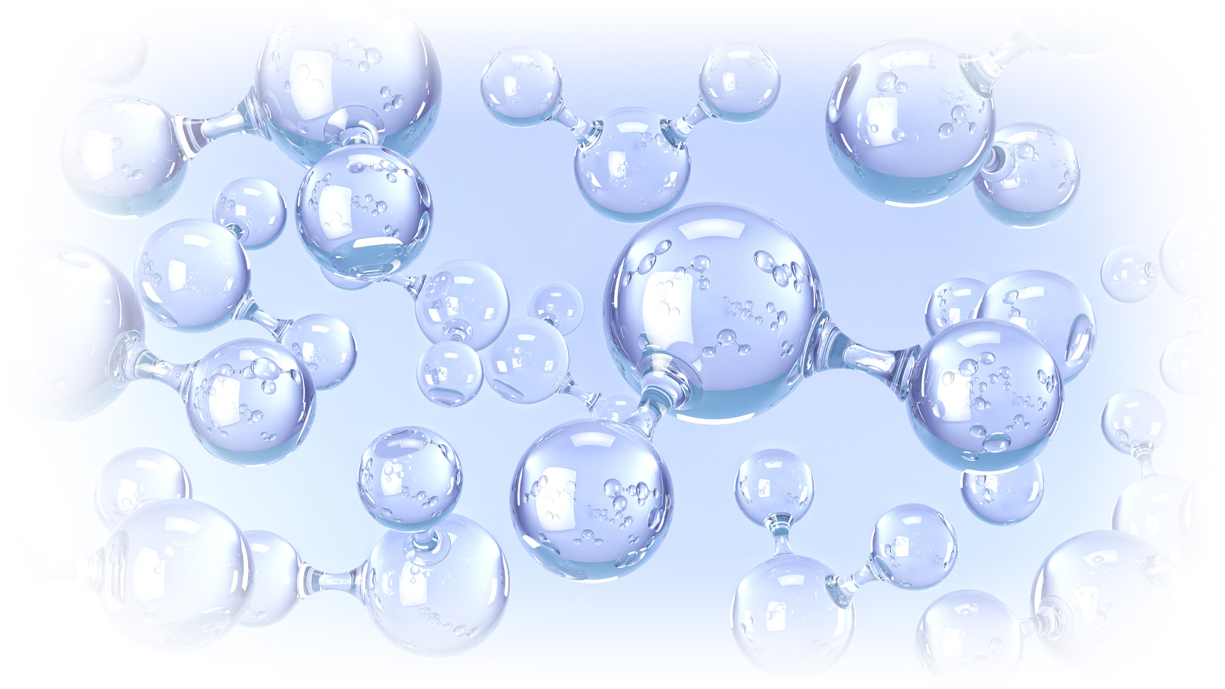
Hydrogen is the Key
Burns cleanly
Produces only water vapour
Burns hotter than gasoline

Slide 17

Most abundant element on Earth
(oceans have an inexhaustible supply)

Slide 18

Our process can power anything and everything.

Slide 19
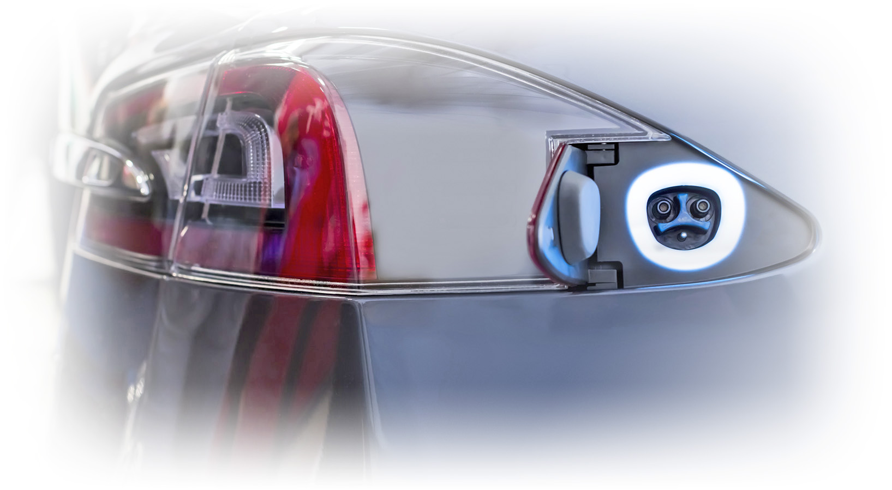
Hydrogen Fuel Cells in Vehicles
Transportation sector already
transitioning to hydrogen
Refilling stations could produce
onsite hydrogen for retail sale
Or fuel commercial vehicle fleets

Slide 20

Ag & Industrial Operations
Hydrogen for fuel cell equipment & machines
(used by New Holland & Cat now)
Perfect for utility companies — refurbish
& adapt existing sites

Slide 21

Added Value
Creates electricity, heating, cooling
for any property needs
Scaled-down version for homeowners
Excess electricity fed back to grid
for income

Slide 22

Everyone is a potential customer!

Slide 23

The Process
Capture free energy from wind, solar,
wave motion, tides, etc.
Use that energy to extract hydrogen from
water via electrolysis

Slide 24

Compress and store the output in pressure
vessels or underground caverns
Clean hydrogen & oxygen then used to
produce electricity in many forms

Slide 25

The Benefits
Zero emissions for a cleaner planet
Not inherently dangerous, and not as
costly as burning fossil fuels
With storage, utilities can deliver energy
whenever the system needs it

Slide 26
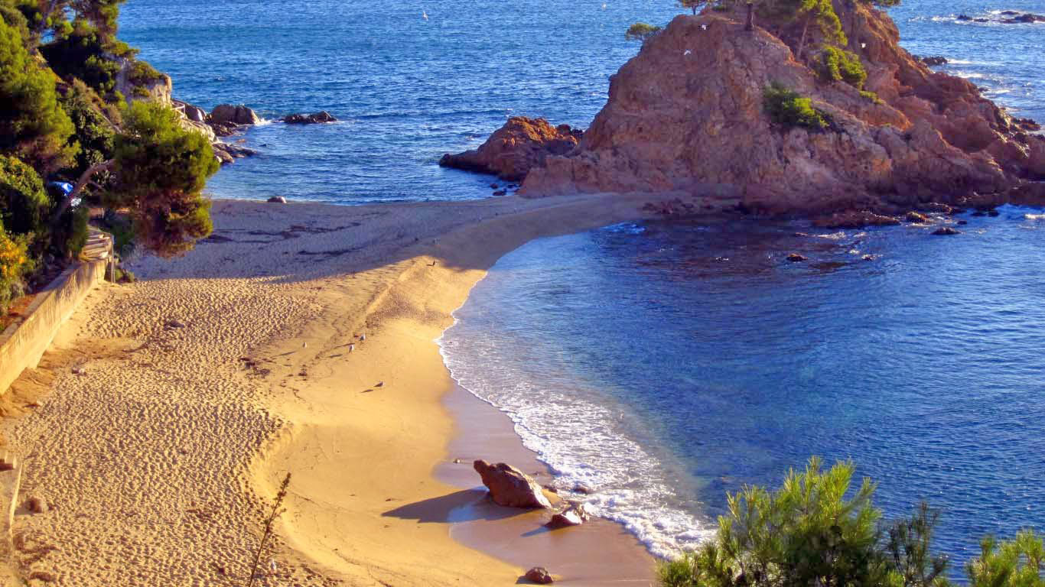
The Benefits
Using abundant sea water produces
marketable by-product of sea salt
No longer at the mercy of volatile oil markets
Limited exposure to the shock of global
crises like coronavirus

Slide 27

Would you rather lead or be left behind ?

Slide 28
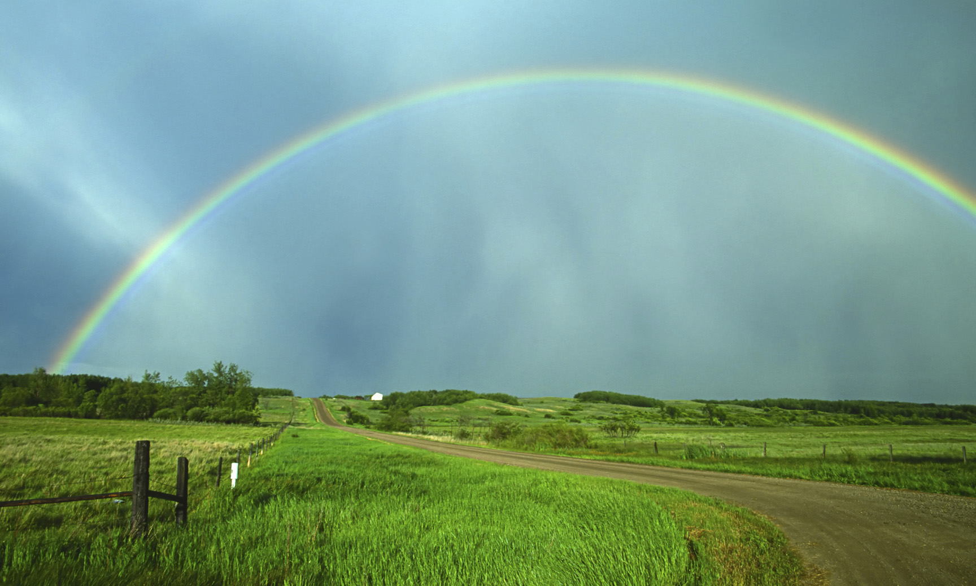
Seize the Day!
Public support for clean energy is surging;
the world is ready for this!

Slide 29

Over the last 24 years (excluding the
Trump administration), US federal agencies
have funded R & D, and provided tax
incentives for clean energy

Slide 30
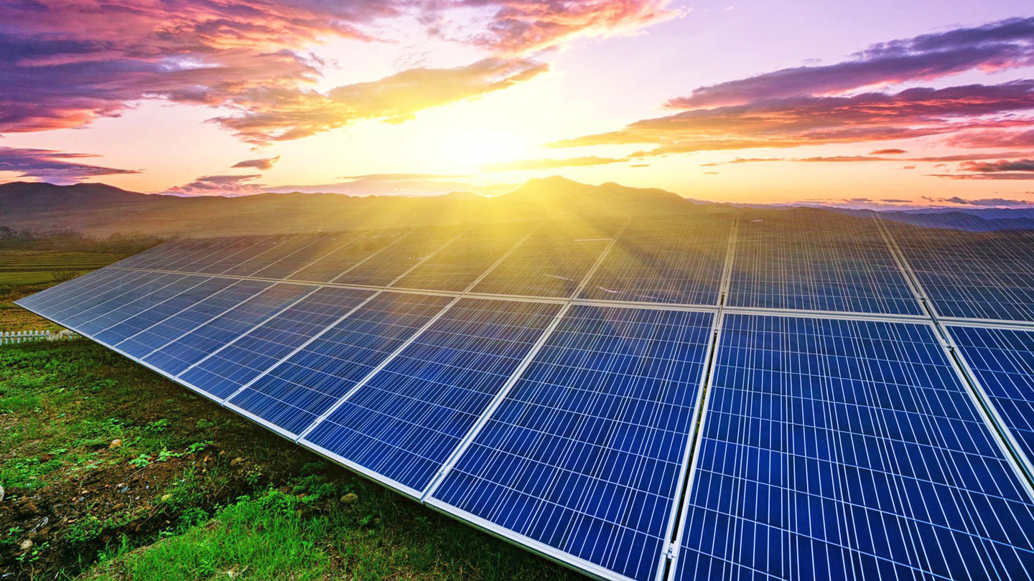
In Canada, $1 billion has recently been
allocated for innovation in clean energy

Slide 31
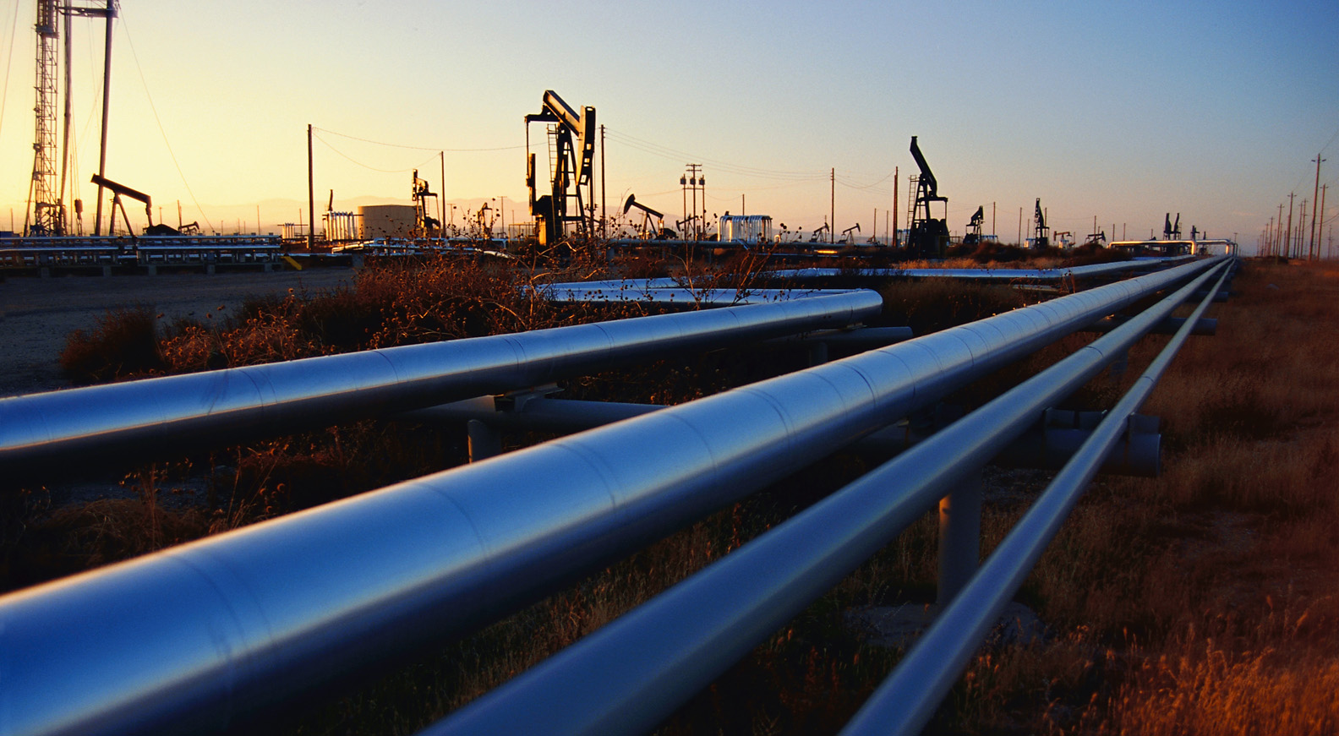
Transition is Achievable
Companies can transition from burning
fossil fuels to on-site manufacturing
of value-added products
For example, coal producers can transition
to making carbon fibre

Slide 32
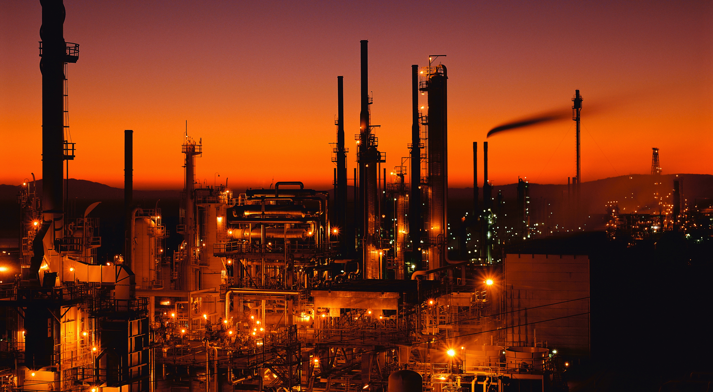
Current oil and gas economies
won’t be destroyed, just redirected

Slide 33

Integrate support for clean energy
into Covid-19 recovery programs

Slide 34

Market Dynamics
Markets favour low-cost energy
Markets emphasize the long view;
aging coal plants are of decreasing value

Slide 35
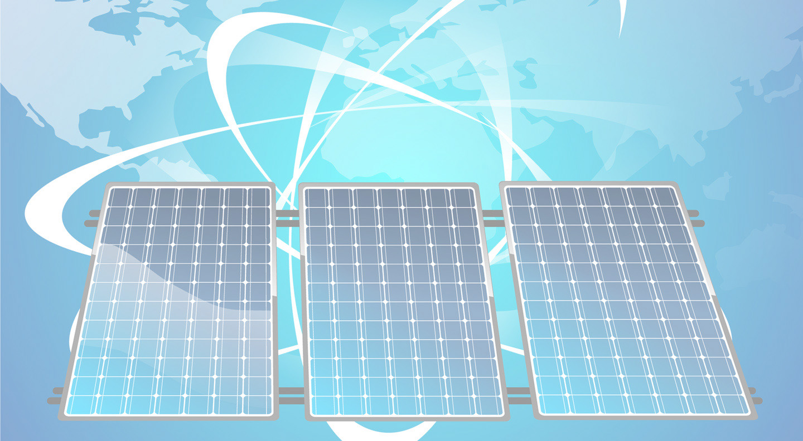
Hydrogen is the future of clean energy
Investments in renewable resources
represent the best return for investors

Slide 36

The Next Steps
Secure start-up investment capital
of $10 million
Secure strategic project site,
preferably near sea water

Slide 37

Incorporate rental properties on the site
to subsidize the operation until it can
generate its own income
Develop & display as many variations
of the process as possible

Slide 38
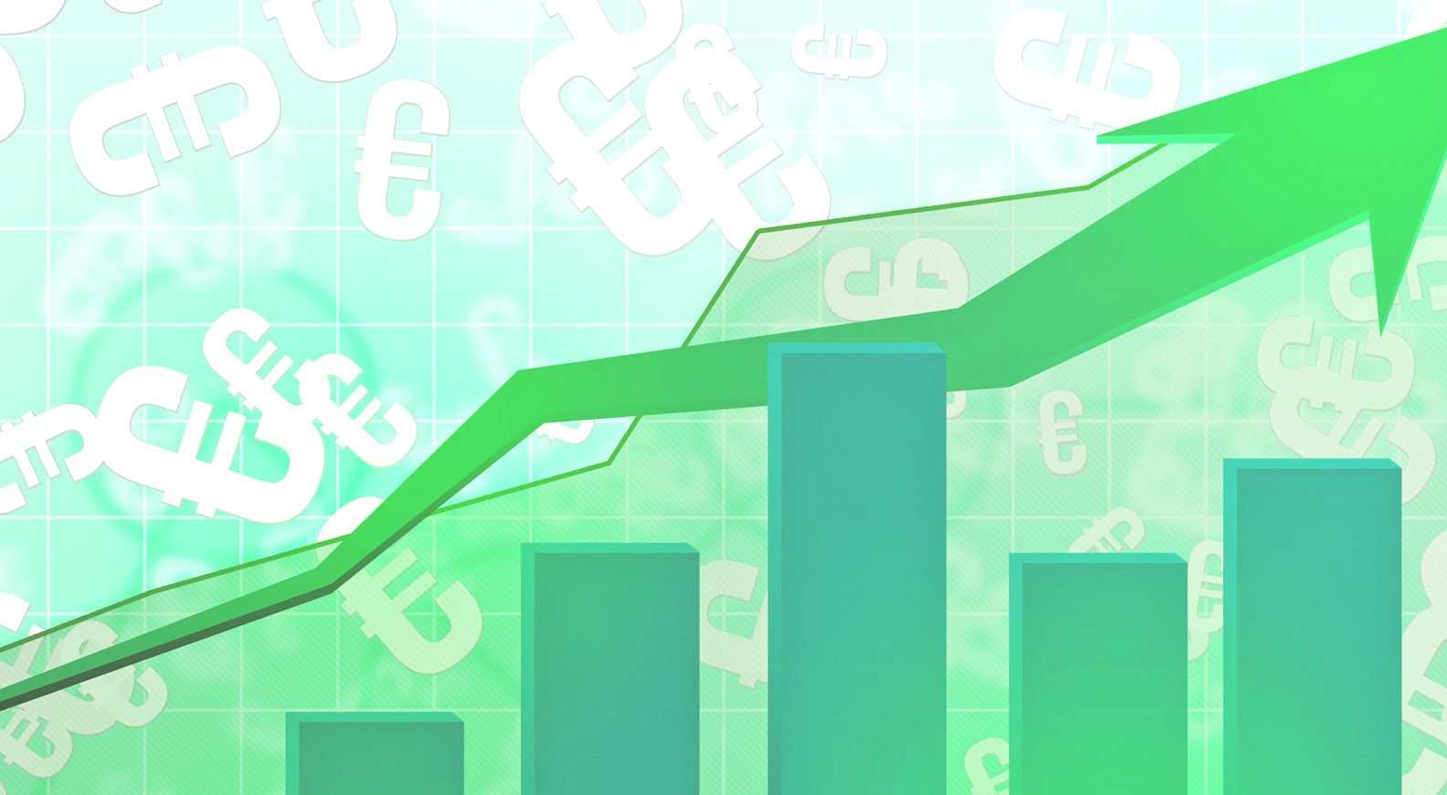
Formalize global patent status
(currently pending)
Use accumulated data to generate more
capital and prove sustainability

Slide 39

Be part of t he solution!

Slide 40

Participate in this
innovative venture!
Buy equity shares today.
For more information ...

Slide 41

Visit www.paladincleanenergy.com
Email paladin@sasktel.net
Phone 1.306.536.1567

